Slide 1
Serializability & Recoverability
Classifier
Architecture of DBMS Project Seminar
Fall 2017

Slide 2
Transaction
A “Transaction” is a sequential set of operations executed on a few data items that take the present database state to an updated database state.
The generated state of the database can either be recoverable or not recoverable.
Generally, executed transactions are meant to be recoverable, and we have various conditions and algorithms to check its recoverability, and what happens to the database if the transaction is executed.

Slide 3
Schedule and History
A History can be termed to as a complete execution of a set of concurrent transactions. The set might contain both aborting transactions and committing transactions.
A Schedule can be called as a prefix (or) a subset of a History. It is a situation where the combination of Transactions have not completely executed. The set may or may not contain both aborting and committing transactions.

Slide 4
Serializability
Serializability is a simple check of consistency state of the database.
The database must be in a consistent state before and after the execution of the History or schedule.
We can follow multiple algorithms to check whether if an execution is either serializable or not. They are :
Generating a Serializability Graph SG (By checking all the “reads from”)
By checking the order of conflicting operations (Used algorithm in this project)

Slide 5
Serializability
To check Serializability,
While i<j,
All conflicting operations of T_{i} must come before all the conflicting operations of T_{j} (T_{i} T_{j})

Slide 6
Recoverability
There can be situations where the history execution might probably get stopped in the middle - because of external factors such as a system failure.
Recoverability of a history can clearly indicate if the database can be recovered from the partial execution.
It also indicates how many transactions have to be rolled-back or rolled-forward to recover the database.

Slide 7
Recoverability
A History can be recoverable, if
i<j,
T_{i} T_{j} (T_{i} Reads from T_{j})
c_{j} < c_{i}
a_{i} < a_{j}

Slide 8
Avoid Abort , STRICT History
ACA: If a transaction reads from an already committed (or) aborted transaction, it is an ACA.
ST: If a transaction both reads and writes on a data item after a committed (or) aborted transaction, then it is a Strict History.

Slide 9
Random History/Schedule Generator
Uses poisson distribution to randomly generate numbers
These randomly generated numbers are used at decision points
Commit / Abort
Data items used
Operations used
Number of operations used in history/schedule
Order of operation execution

Slide 10
Random History/Schedule Generator
Each history/schedule uses initial parameters of number of transactions and possible data items to generate transactions
Each transaction randomly determines the number of operations it will contain
The data items to be used in each transaction is randomly selected from the data items passed to the history/schedule
Once the transactions get generated the operations are randomly selected from each transaction into a list to determine the “order of execution” for the given history/schedule
The order is stored in a list to be used later in the program and for outputting

Slide 11
Random History/Schedule Generator
Operation data structured as a tuple (operation, data item)
These are stored in a list in each “Transaction” object
Each transaction take the data items to be used, number of operations, and if it “completes” (schedule)
Each transaction has a list of these operations

Slide 12
Random History/Schedule Generator
History(numOfTransactions, [dataitems]) -> generate transactions -> order transactions
Generate transactions(numTransactions, possibleDataItems) -> for number of transactions: randomly determine data items used, randomly determine number of operations -> create transaction(dataitems, numberops)
Create transaction -> Generate operations(dataitems, numberops) -> for number of ops: randomly select data item, randomly select operation -> randomly select abort/commit if “completes”
Orders transactions

Slide 13
Methodologies and Algorithms
Serializability
We first divided the generated History and Schedule into separate lists based on Data items.
Generated conflict pairs of History and Schedule (Checked with R and W operations of different Data items (and) W and W operations on same Data item by different transactions)
Then, we generated all the combinations of Serial executions of the available transactions and generates Conflict Pairs of every serial execution.
If the generated History matches with the Conflict Pairs of any of the serial executions, then it is Serializable, else it is Acyclic (Not-Serializable)

Slide 14
Methodologies and Algorithms
Recoverability
We first check the reads from relation of the generated History and get a Reads from relation of Transactions of History
We then check the Abort and Commit operation orders of the Transactions and check them according to recoverability theorem.
j<i,
T_{j} T_{i} (T_{i} Reads from T_{j})
c_{j} < c_{i}
a_{i} < a_{j}
c_{j} < a_{i}
a_{i} < c_{j}

Slide 15
Methodologies and Algorithms
Recoverability
ACA
Checked whether the previous transaction have committed or aborted before the next transaction started reading or writing on data from the previous transaction
ST
Checked whether the previous transaction have committed or aborted before the next transaction started to both read and write on data from the previous transaction

Slide 16
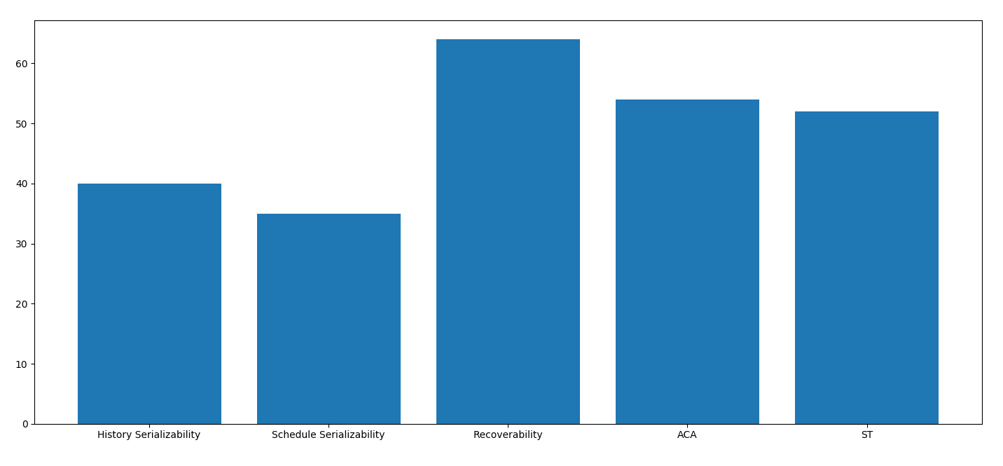
Performance Graph
The performance graph shows the total number of occurrences of Serializabilities for both generated History and Schedule, ACA, ST and Recoverability of the History.
To do so, we created a csv file and wrote all the execution outputs to the file each and every time the program is run.
After around 50 to 100,executions, we get an idea of what the program is generating by looking at the graph output, which is a bar chart.
No. of Executions

